Slide 1

U.S. YouTube Case Study Analysis
Jan 2026 DDI-A Cohort

Slide 2
Overview of Data Set/Analysis
Columns consisted of:
Video ID
Trending date
Title of the video
Channel title
Category ID
Publish time
Views
Categories
We approached the data set with the objective of discovering the most valuable business insights to boost the growth of insert Chad’s company name here.
We identified the patterns between YouTube viewership in relation to the most popular categories and the best time of day/week to post content.

Slide 3
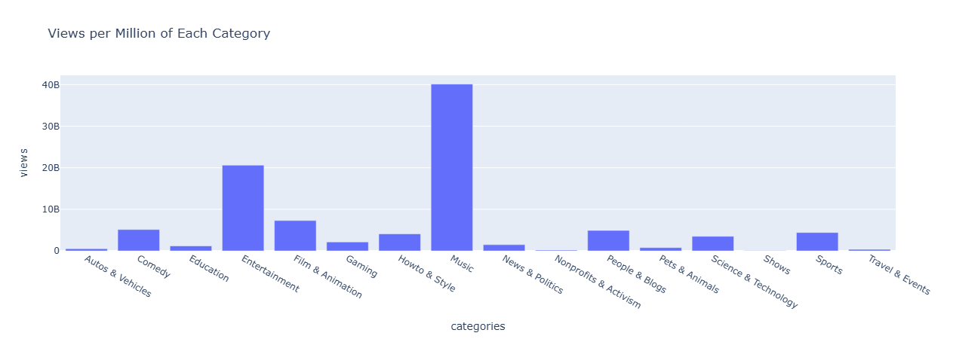

Slide 4
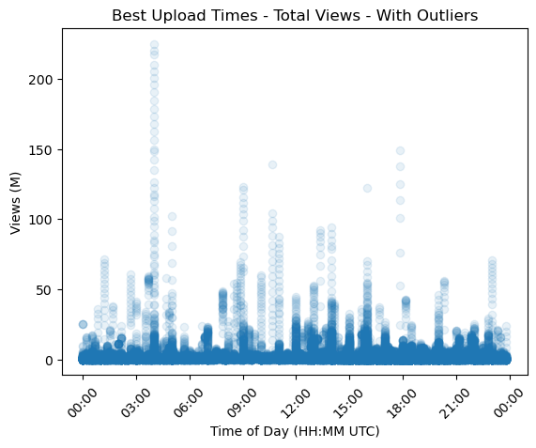

Slide 5
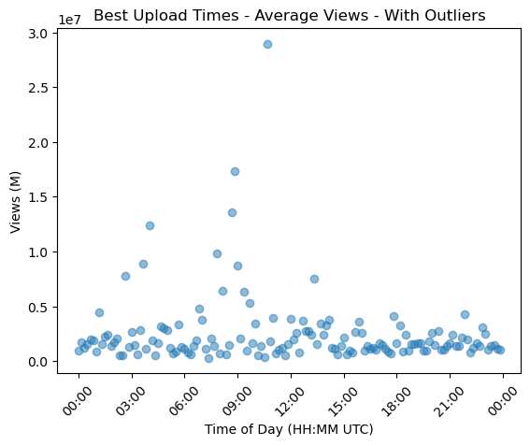

Slide 6
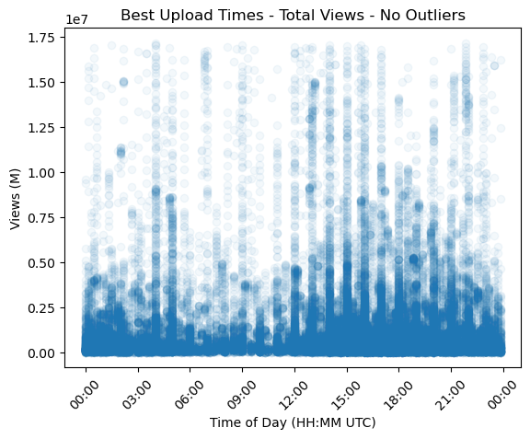

Slide 7
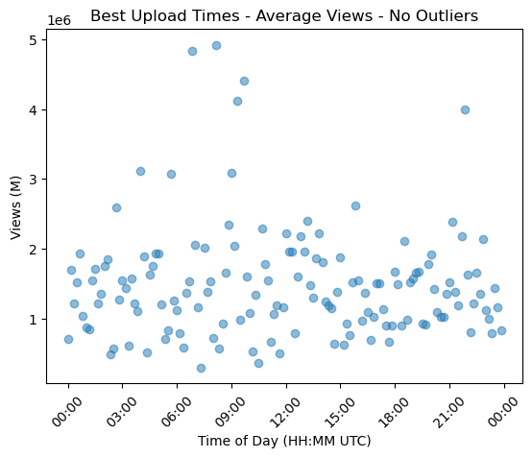

Slide 8
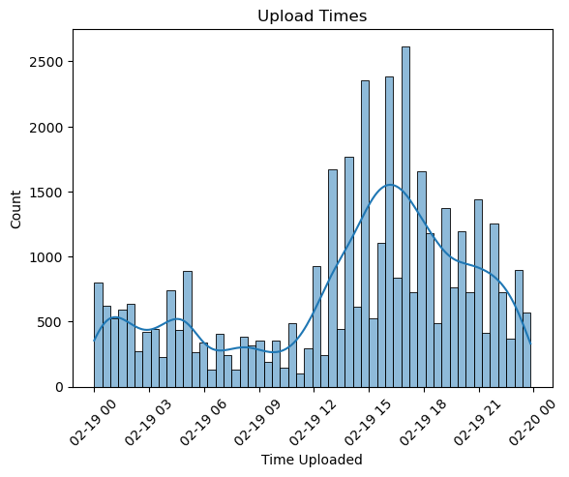

Slide 9
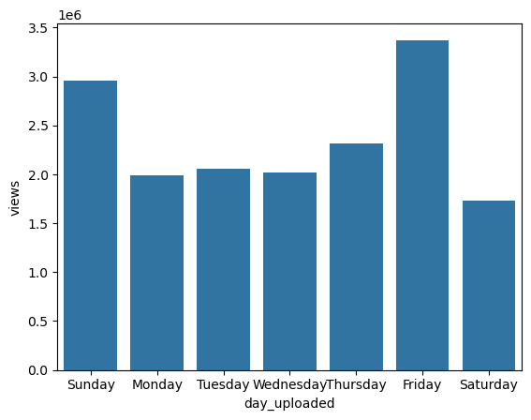

Slide 10
Projected Benefits
Understanding of optimal day & time to post videos
Understanding of most popular topics for viewers
Will then allow marketing team to target specific content with advertisements to generate more revenue
Increase partnerships with popular creators within the specified top categories to boost overall website traffic

Slide 11
Questions?

